Slide 1




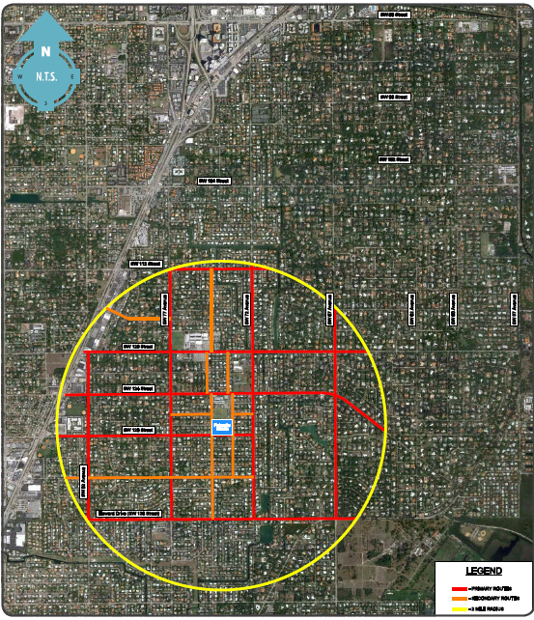
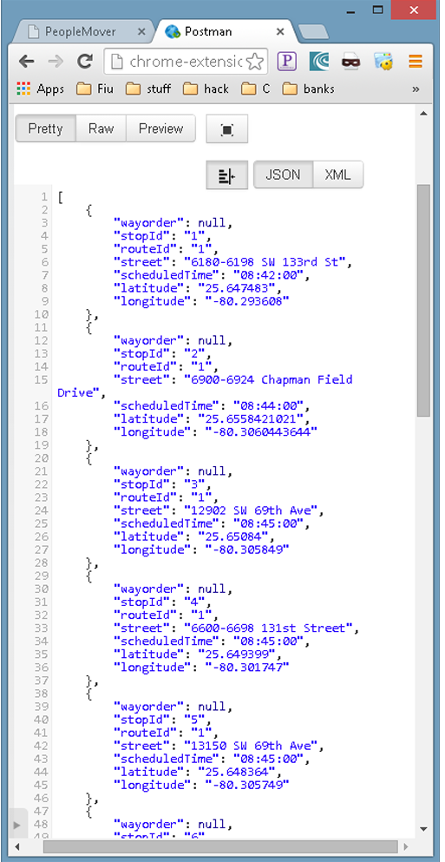
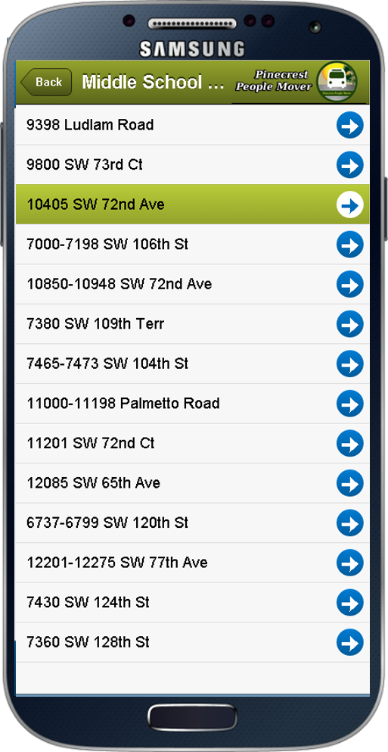
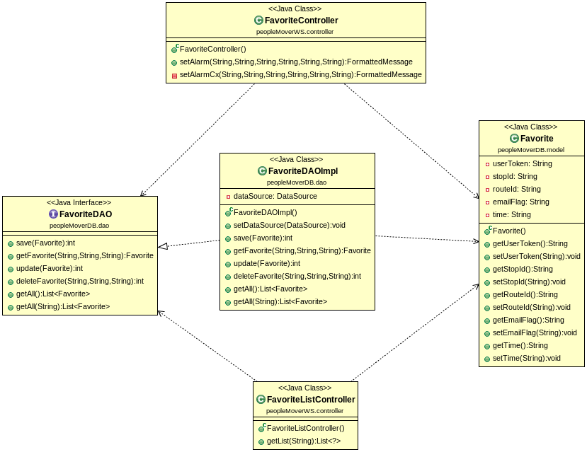
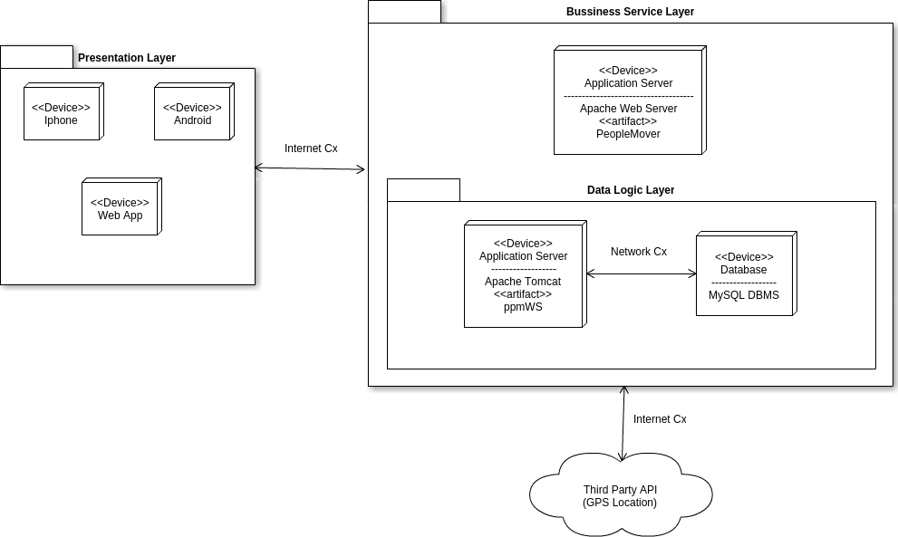
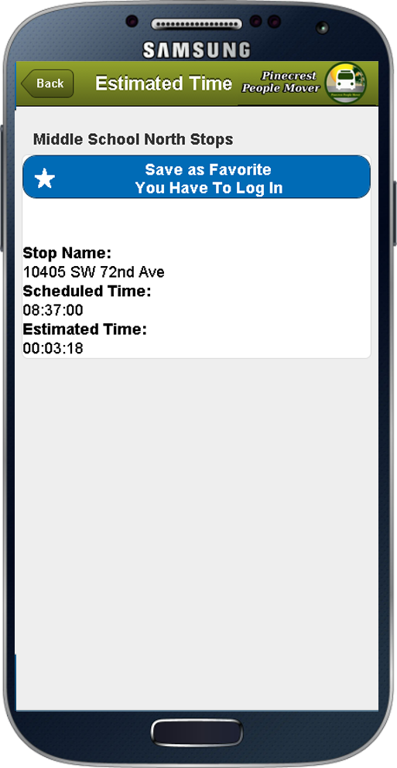
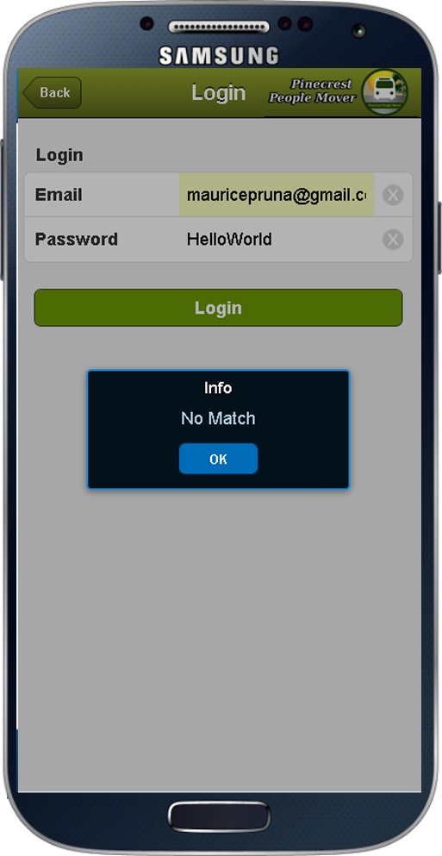
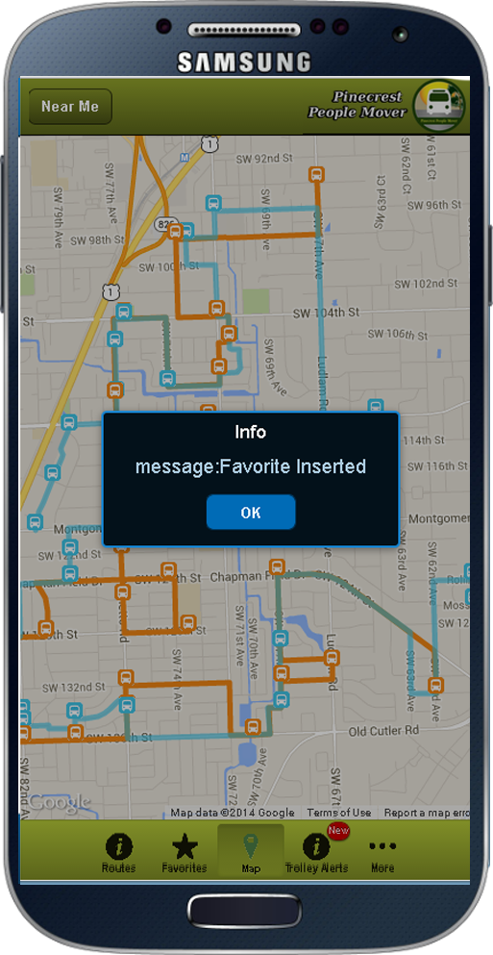
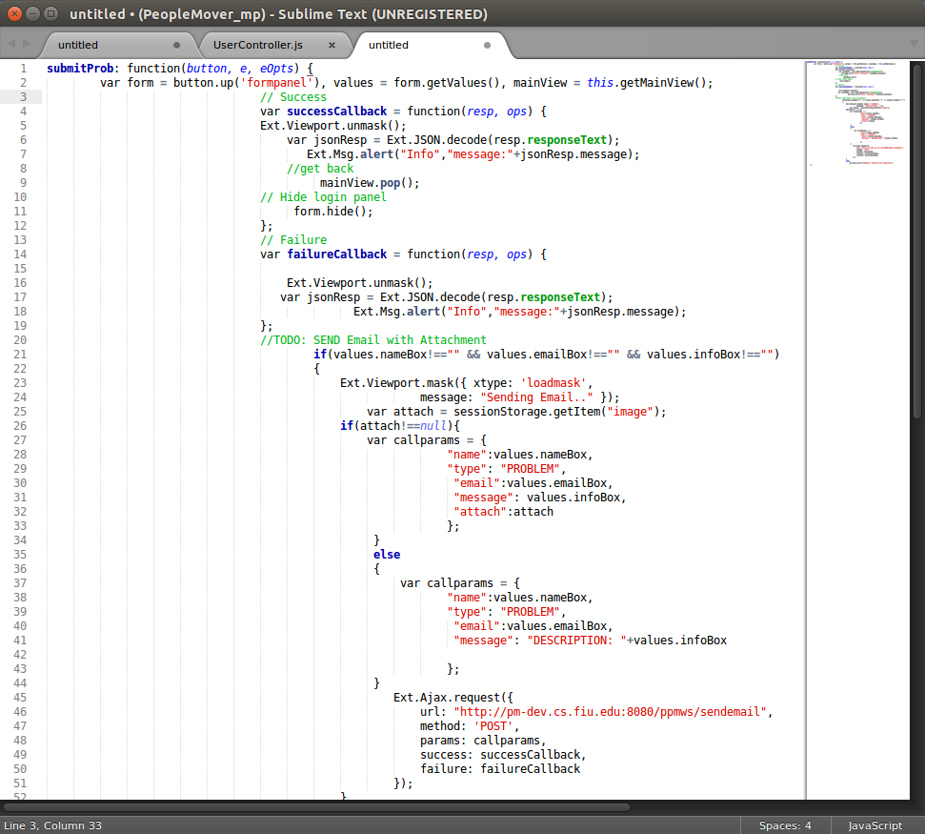
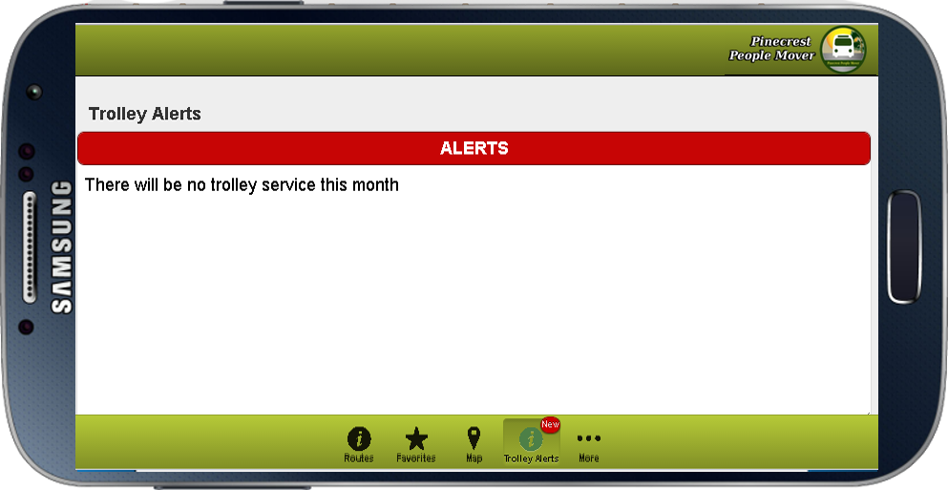
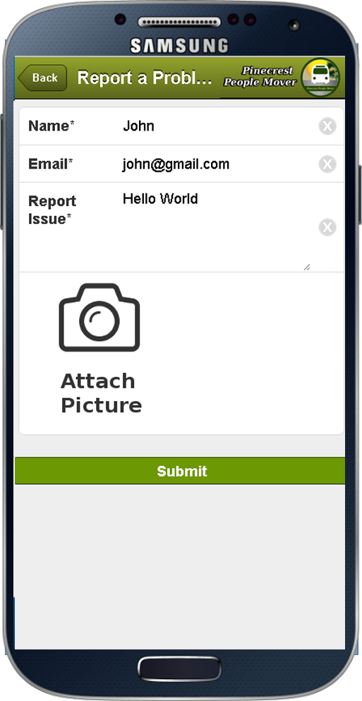
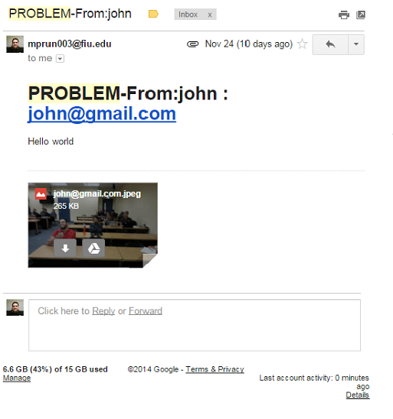
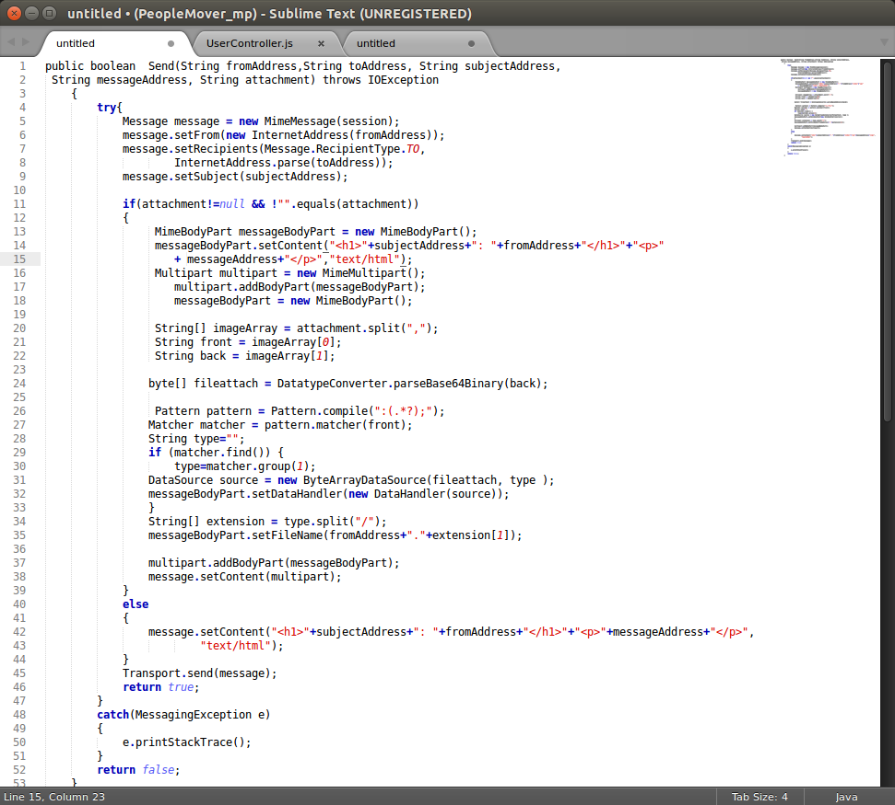
Pinecrest People Mover App - Senior Project Fall 2014
Student: Maurice Pruna, Florida International University
Mentor: Gabriela Wilson, Village of Pinecrest Instructor: Masoud Sadjadi, Florida International University
School of Computing & Information Sciences
Problem
Palmetto Middle School
Requirements
The Village of PineCrest is providing a free trolley service for their residents with special interest on the students that do not qualify for regular school bus. Pinecrest parents are in need of a tool that allows them:
Track the mover
Get estimated time of arrival to stop,
Receive notifications from system.
My job was aimed to make possible the proper transferring of information between the GPS API, our API and the client subsystem. The implementation of the email subsystem and data access .
The system should allow the user:
Display Hours of Operation
Receive Trolley Alerts
Set Favorite Stop
Remove Favorite Stop
List Stops for a specific route
Login
Register
Request Stop
Report Problem
Send Feedback
Receive Trolley Arrived to Location Alert
Current System
Screenshots
Object Design
Get List Stops Phase
Favorite Classes Definition
There are several transportation tracking alternatives being used on Miami-Dade. However non of them is focused on the vision Pinecrest administration has for their citizens. Currently, the trolleys are mainly used as alternative to get to local schools, but their customers have no way to know the estimated time for next mover while waiting at a stop, or the nearest stop to their actual position.
System Design
Deployment Diagram
Set Favorite Phase
Implementation
This project was implemented using JavaScript with Sencha Touch framework that allow to generate HTML5 that could be deployed in mobile devices. The data access is managed with Java using Spring and JPA to connect to MySQL. Spring framework also provided the functionality to create Rest services that is consumed by the client application (Sencha).
Submit Problem (FrontEnd)
Verification
Get Alert Phase
Integration Testing:
Established that the API backend was working as expected with the frontend. We validated that the functionalities where accomplished using the used cases already defined.
Manually Exploratory Testing: The system was extensible tested by imitating the role of the regular, registered and admin user as well. All the features of the client application were tested to ensure proper behavior.
Summary
Submit Problem Phase
Send Email (BackEnd)
Pinecrest residents can take advantage of the first stage of the Pinecrest People Mover App. They could find that the system could now provide them with functionalities like tracking the bus, find near stops, receive system alerts, and define favorites as well.
This version sets the roots for future development in continue improvement of the actual system.
Acknowledgement
The material presented in this poster is based upon the requirements specified by Gabriela Wilson.
Special thanks to my Family, my team partner: Ricardo Martinez; Mitchell Simoens , Dan Camaraza from Sencha Forum
and our mentor Gabriela Wilson.
The material presented in this poster is based upon the work supported by … I am thankful to the help that I received from my group members, … .

